Slide 1








Trading Bot on BTC
By Mohsine Zireg, Wassim Belhaj, Clément Boulay, Matthieu Briet, Tanguy Colleville
Notes:
Travail commandé par le MMSAt bref présentation du labo et énoncé du titre du projet
Pierre

Slide 2


Summary
Exploratory analysis and feature engineering
Work an classical modelling
Model with deep learning : recurrent neural network
Conclusion
Notes:
Enjeu de génie civil sur les sites à risques Tanguy

Slide 3

Data science project :
Process
Modeling
4
Preprocessing
3
EDA
2
1
a measurable goal
RMSE < 2855 $
Notes:
Ambition + Démarche

Slide 4
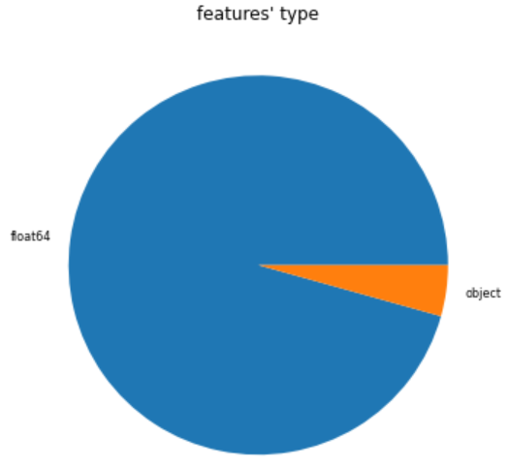
1) Exploratory Data Analysis : Shape
1 dataframe [841.1 Kb]
23 columns corresponding to different features
3544 rows corresponding to different days
Target : "market-price”
NaN ? Almost not
Which type ?

Slide 5
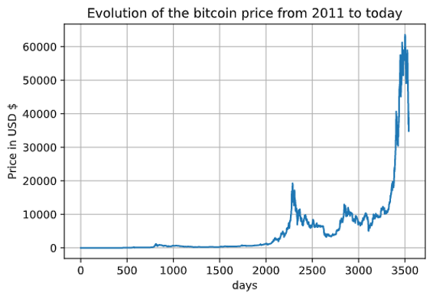
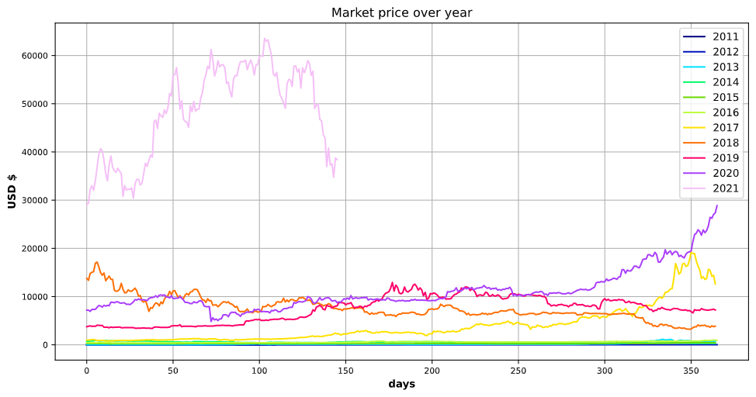
1) Exploratory Data Analysis : Content
A) Target Vizualisation
2 differents behaviours

Slide 6
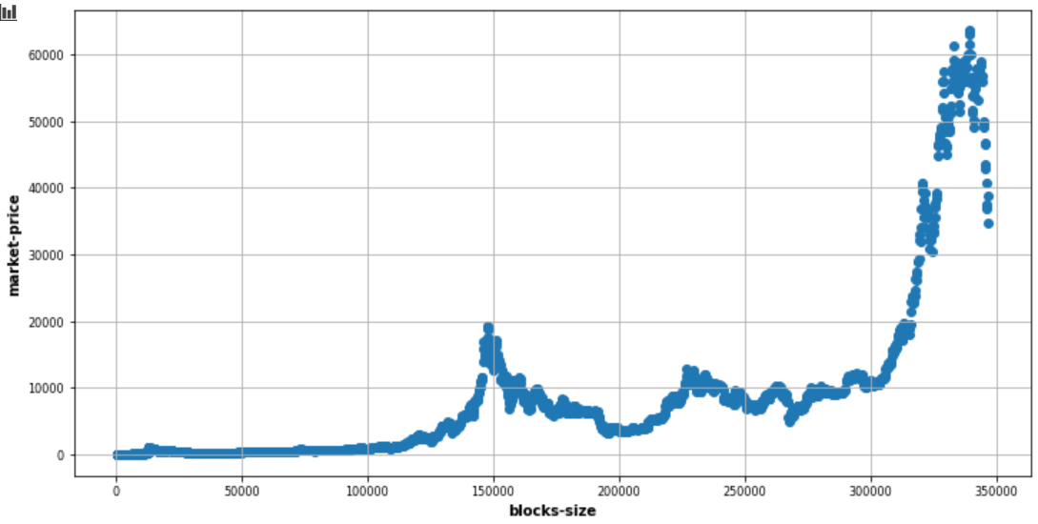
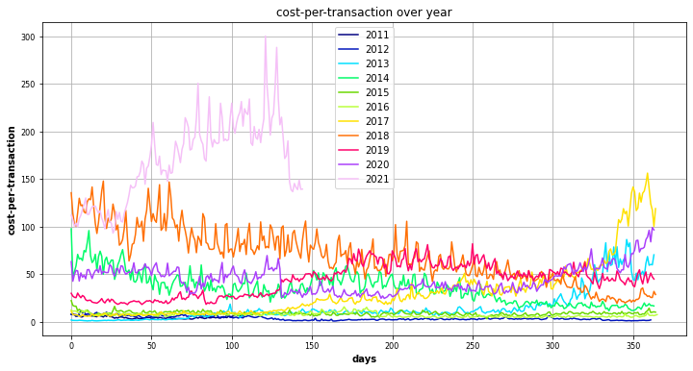
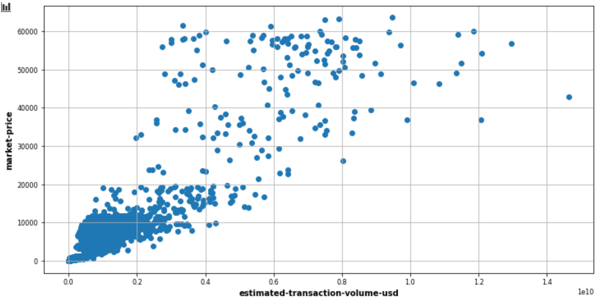
1) Exploratory Data Analysis : Content
C) Target & features distribution ?
B) Meaning of variables ? Array of information
D) Seasonality ?
E) Outliers ? Not really

Slide 7
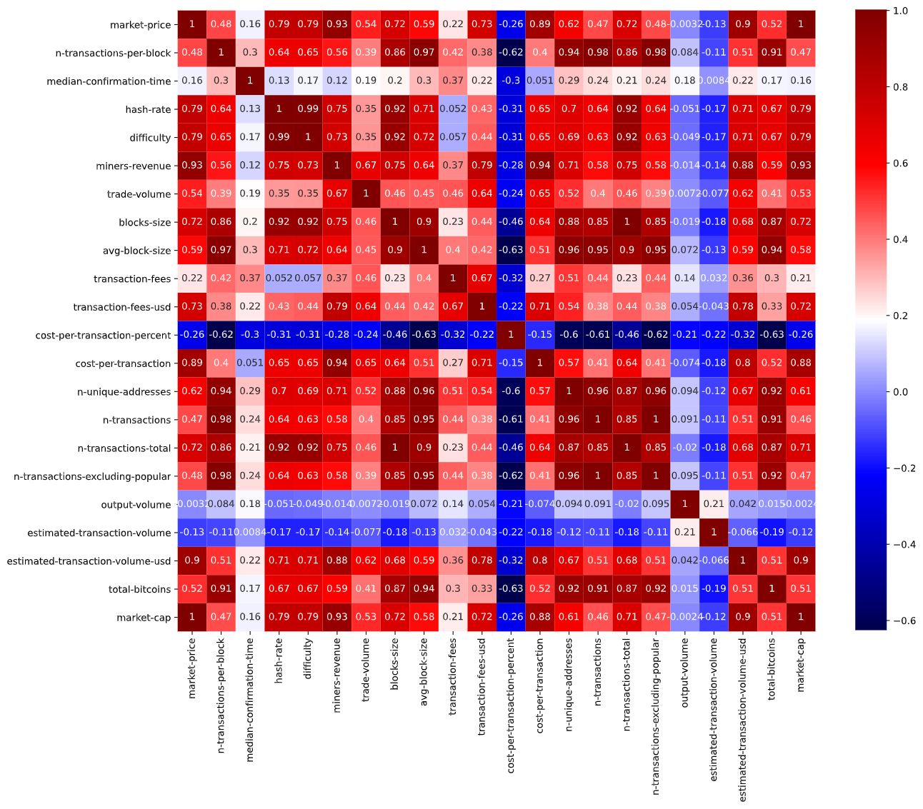
1) Exploratory Data Analysis : Content
F) Correlation ?
Are all this features relevant to forecast the price?

Slide 8

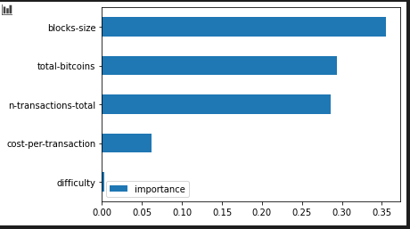
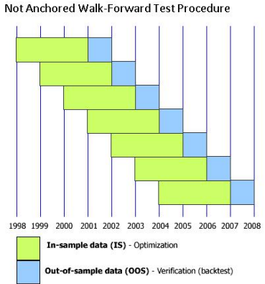
2) Preprocessing
Data from day 2000 : (12/03/2017)
Creating features from "Date" "Week day" ; "Month" ...
Analysis of the distribution of the features (symmetry)
Normalization and standardization of the features
Searching for relevant features (correlation and importance with random forest regression)
Cross validation temporality respect
Processing by batch for RNN

Slide 9

3) Classical Modelling
Model | Best Fit | RMSE
ARMA | ARMA(3,0) | 2866 $
ARIMA | ARIMA(1,1,2) | 2862 $
ARIMAX | ARIMAX (1,1,2) (15 relevant features) | 2850 $
ARIMAX | ARIMAX(2,1,1) (8 relevant features) | 2737 $
- 4 %
A huge set of parameter to evaluate, maybe not the best possibility

Slide 10
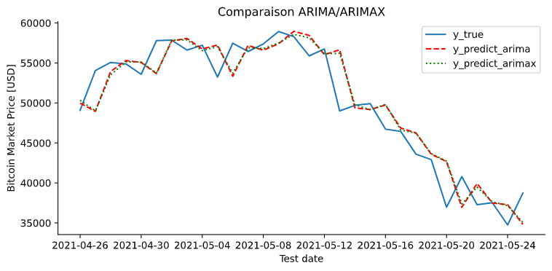
3) Classical Modelling
No real difference

Slide 11









4) Deep learning
Complexité
LSTM & Dense
ANN Dense
CNN & LSTM & Dense
Notes:
Nico

Slide 12
4) Deep learning : Results
Notes:
Nico

Slide 13
5) Comparison between models
Model | Execution Time | Number of parameters | RMSE
ARIMAX(2,1,1) | 20s | 8 | 2737 $
Notes:
Nico

Slide 14



Conclusion
Done
The future ?
Goals
EDA
Preprocessing
ARIMA
ARIMAX on different set
RNN / ANN
Features engineering improvement
Hyperparameters Fine Tuning
Architecture improvement
ARIMAX with different sets of features
Reduce RMSE with ARIMAX( best set)
Same with Deep learning solution
Notes:
Alexandre

